Slide 1


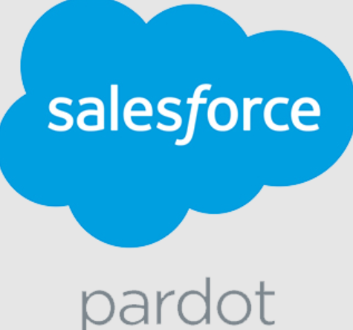


Aroma360: Sedin's Salesforce Optimization
Aroma360 is a leading provider in scent marketing and branding, offering sophisticated scent solutions across multiple brands. The company operates through various sub-brands and needed a unified digital presence to enhance their e-commerce capabilities.
We provided Development Support for a Major Enhancement project for Aroma360 in the US, focused on Salesforce optimization and integration fixes.
Challenge
Benefits
System Performance Issues causing operational delays
Data Integrity Issues compromising information reliability
Unstructured data cluttering the production environment
Non-adherence to best practices in testing and data management
Integration problems between Shopify and Salesforce
Limited Salesforce knowledge within the organization
Reduced system downtime by 85%
Improved performance and processing times
Enhanced data integrity for reliable business decisions
Streamlined operations through optimized processes
Better development practices via Agile and DevOps
Seamless e-commerce operations with reliable integrations
Reduced maintenance overhead by removing unnecessary customizations
Solution
Salesforce optimization improving system performance
Custom-built integration replacing problematic middleware
Streamlined order management processes
Implemented Agile methodology with Jira for issue tracking
Established DevOps using GitHub
Provided daily scrum support and offshore assistance
Technologies

